Slide 1
Oportunidad para Expandir la Capacidad del Cuidado de Niños
Communities for Kids
en honrosa asociación con
Departamento de Salud y Servicios Humanos de Nebraska
Notes:
Welcome! Nebraska Children and Families Foundation’s Communities for Kids initiative—through its proud partnership with the Nebraska Department of Health and Human Services and the American Rescue Plan Act—is excited to announce a funding opportunity to communities and child care professionals across Nebraska that will assist in expanding capacity of high-quality early learning programs. Today, we are going to go over the highlights of the project including an overview, timeline, allowable expenditures, and how to apply.

Slide 2
Ley de Plan de Rescate Estadounidense
“Este proyecto es posible gracias al financiamiento que el Departamento de Salud y Servicios Humanos de Nebraska recibió a través del Proyecto de Ley 1014 de Nebraska: asignación de fondos asignados al Estado de Nebraska del Fondo de Recuperación Fiscal del Estado por el Coronavirus según la Ley Federal del Plan de Rescate Estadounidense de 2021, 42 U.S.C. 802.”
Notes:
This is the official statement that includes the legislative bill number and name and number of the congressional act. You will see this statement on everything we put out about the funding, and if you are chosen to be a contractor for these funds, it will also be on all of your materials as well.

Slide 3
Incremento de Capacidad con Licencia
Debe haber CRECIMIENTO visible de la capacidad con licencia para el cuidado de niños en programas de alta calidad
Debe participar en el programa Step Up to Quality
Debe registrarse en la Red de Referimientos para el Cuidado de Niños
Debe estar dispuesto a aceptar a los niños bajo subsidio
Notes:
This project is solely focused on increased child care capacity, especially in areas of high need. To be eligible for funding, providers must be starting a new program or expanding their current one to serve more children. Please only apply if you plan to meet this criteria.
Applicants can be a community, individual child care program, or business seeking to incorporate child care. Applicants will be required to show they can increase full-day, full-year licensed child care capacity for the 0-5 population. These funds and can go either to a community working with many child care programs, or individual child care programs.
Applicants must be willing to participate in the Step Up to Quality program, and develop a plan to reach Step 3 or higher. They must also register on the Child Care Referral Network, often called the CCRN, and must be willing to sign a contract with DHHS to accept children who qualify for child care subsidy.

Slide 4
Oportunidades Aceleradas
Fecha Límite para la Entrega de Propuestas:
Marzo 24, 2023, 5pm CST / 4pm MST
Anuncio de Contratos:
Mayo 15, 2023
Periodo de Contrato:
Julio 1, 2023 – Junio 30, 2024
Todos los programas que reciben fondos deben estar abiertos, operativos y aceptando niños a más tardar el 30 de junio del 2024
Notes:
This project is on an accelerated timeline, which means there will be a very limited time to spend a large amount of funds. We need your proposals by March 24th, contract announcements will be made May 15th, and the contract period is 7/1/23 – 6/30/24. All of the funding must be spent in that contract period. There will be no carryover of funds past that date. It is also important to note that any program that participates must be open, operating, and accepting children no later than June 30, 2024.
Technical Assistance to support your project(s) will be provided by Communities for Kids staff.

Slide 5
Información de Fondos
El proyecto incrementará la capacidad con licencia por | Cantidad de los contratos
2-12 niños | Hasta $50,000
13-24 niños | Hasta $135,000
25-50 niños | Hasta $200,000
51-75 niños | Hasta $250,000
75+ niños | Hasta $300,000
Notes:
We will contract with a minimum of 9 and a maximum of 12 entities based on the funding amount in this chart. For example, if a single child care provider applied and would be able to increase their licensed capacity to between 51-75 children, they would be eligible for a $300,000 contract. If one community applied with plans to open 3 new Family Child Care Home Ones, serving 8-12 children, they’d be eligible for a $150,000 contract, because they’d be serving 3 providers at that $50,000 threshold. Applicants are welcome to mix and match different types of providers in their applications.

Slide 6
Cómo Presentar una Solicitud
Completar el formulario de solicitud de fondos
Escribir la propuesta (encuentre los detalles completos en el documento de descripción general de Solicitud de Propuesta en el sitio web de C4K)
Completar el Formulario de Solicitud de Fondos
Completar el Presupuesto
Completar la Justificación del Presupuesto
Programas de Hogar Familiar
Debe incluir un informe de inspección para verificar que las
renovaciones que está solicitando son necesarias para poder
obtener la licencia.
Envíe el PDF completo por correo electrónico a C4Kinfo@nebraskachildren.org
Notes:
To apply, you will be asked to complete a request for proposal, which will be available on our website. The Request for Proposal will also need to include a summary form, a funds request form, a budget, and a budget justification. All documents will need to be emailed to Nebraska Children, Communities for Kids by March 24th at 5:00 PM CST/4:00 PM MST, as mentioned earlier. C4K will make all required forms available on our website.

Slide 7
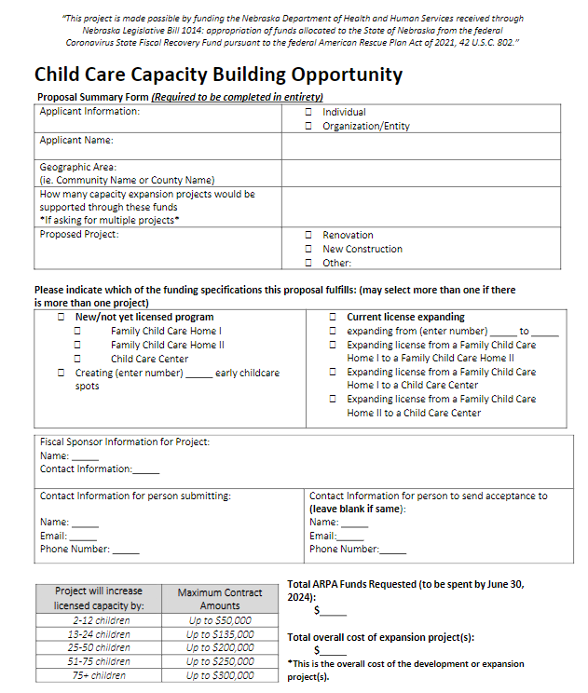
Requisitos para RFP
Información del Solicitante
Área Geográfica
¿Cuántos proyectos?
No dentro de un programa
Nuevo, aun no licenciado vs. Con licencia vigente
Información del Espónsor Fiscal
Información de Contacto
Todos los formularios están disponibles en la página web de C4K: https://www.communitiesforkids.org/arp.html

Slide 8
Proceso de Selección
Se seleccionarán 9-12 propuestas para recibir contratos
La intención es financiar una variedad de diferentes tipos de programas incluyendo rurales y urbanos
El equipo inicial de personal interno de Nebraska Children y socios externos revisarán y realizarán recomendaciones
El Departamento de Salud y servicios Humanos de Nebraska-DHHS realizará las selecciones finales
Los contratos serán anunciados el 15 de mayo del 2023 por correo electrónico
Notes:
Once Request for Proposals and documents are submitted by the listed deadline, proposals will be reviewed by a team of internal Nebraska Children staff and other external partners. Once this review is complete, Nebraska DHHS will make the final selections for contract awards. 9-12 proposals will be selected for contracts and we plan to announce the recipients on May 15, 2022 via email.

Slide 9
Gastos Permitidos
Construcción y renovación
Materiales para el salón de clase y currículo
Salarios y beneficios
Los salarios solo pueden ser gastados en empleados elegibles que han completado satisfactoriamente una Revisión de Antecedentes Penales para Proveedores de Cuidado Infantil conforme al Estatuto Revisado de Nebraska §71.1912
Reclutamiento de empleados y actividades de contratación
Publicidad
Capacitación
Notes:
There will be a limited list of allowable expenses due to the funding source, which includes but not limited to: Construction and renovation costs (materials and labor), classroom equipment, materials and curricula, staff wages, payroll taxes, and benefits, workforce recruitment and hiring activities, marketing and advertising, and staff training fees.

Slide 10
Gastos No Permitidos
Cualquier cosa que no esté directamente relacionada con el aumento de la capacidad
Alimentos
Artículos desechables
Artículos consumibles (excepto artículos de oficina y artículos utilizados en el plan de estudios, como crayones)
Equipos de $5,000 y más, a menos que haya un permiso especial
Notes:
Expenses not directly tied to increased capacity will not be allowed. The following are examples of non-allowable expenses: Food, disposable items (such as soap, hand sanitizer, paper towels, wipes, diapers, cleaning supplies), or consumable items (except office supplies and/or classroom supplies such as crayons). Any equipment expenses costing $5000 or more for a single item will also not be allowed unless special permission prior to spending is granted. In order to help guide you with creating budgets for expenses, a list of allowable and non-allowable expenses will be provided on our FAQ, which will be accessible on the C4K Website.

Slide 11
Preguntas y Respuestas
2da Sesión: 24 de febrero a las 12:00pm CST / 11:00am MST
https://www.communitiesforkids.org/arp.html
Notes:
We will hold 2 Q&A sessions on _______________. You are encouraged to attend one of these sessions. There is no need to attend both.
We have started a Frequently Asked Questions page on our website as well, which you can find at this link.

Slide 12
!A Comenzar!
Fecha límite para la entrega de propuestas:
24 de marzo, 2023 a las 5pm CST/4pm MST
Anuncio de Contratos:
15 de mayo, 2023
Periodo de Contrato:
1 de julio, 2023 – 30 de junio, 2024
Todos los programas que reciben fondos deben estar abiertos, operativos y aceptando niños a más tardar el 30 de junio del 2024
Notes:
With that brief overview, please note, we need to get started right away! Here is another look at the timeline, as you can see, we are off to the races. We will see you at the Q&A sessions on ____________________

